Slide 1
Co/Cu/Ni₈₀Fe₂₀ Rectangular
(a)
(b)
Co (10nm)
Cu (10nm)
NiFe (10nm)
(c)

Slide 2
For AR = 0.5, a hard-axis loop is observed with a small hysteresis at the center. This is because the elements undergo a transition from easy-axis to hard-axis of its shape anisotropy w.r.t. the applied field direction with the reduction of AR.
For 1.0 ≤ AR ≤ 2.5, we observe 2-step switching, with the squareness of the loops increasing, with the increase in AR.
The size of the plateaus also increase, as we increase the AR.
We observe the systematic decrease in H_{sat} until 1.5 kOe at AR = 1.5, after which it decreases gradually and the systematic increase in H_{c} with the increase in AR.
For AR = 0.5, a narrow MR loop is observed with large spacing.
For 1.0 ≤ AR ≤ 2.5, we observe that the squareness of the MR loops increase while they become wider with the increase in AR, and the space in between decreases.
The loops almost merge at AR = 2.5.
We observe the gradual increase in MR % with the increase in AR and as the loops become wider.

Slide 3
Co/Cu/Ni₈₀Fe₂₀ Elliptical
(a)
(b)
Co (10nm)
Cu (10nm)
NiFe (10nm)
(c)

Slide 4
For the AR = 0.5, we have a hard-axis like loop with no hysteresis at the center of the loop.
For the AR = 1.0, we observe a 1-step switching and a more square-like loop than AR = 0.5 with some hysteresis at the center.
For 0.5 ≤ AR ≤ 1.0, the switching observed in incoherent.
For 1.25 ≤ AR ≤ 2.5, we observe 2-step switching, with the squareness of the loops increasing, with the increase in AR and the magnetic field switching observed is coherent.
The size of the plateaus also increase, as we increase the AR.
We observe the systematic decrease in H_{sat} and increase in H_{c} with the increase in AR.
For AR = 0.5, a narrow MR loop is observed with large spacing.
For 1.0 ≤ AR ≤ 2.5, we observe that the squareness of the MR loops increase while they become wider with the increase in AR, and the space between decreases.
The loops almost merge at AR = 2.5.
We observe the gradual increase in MR % with the increase in AR and as the loops become wider.

Slide 5
Co/Cu/Ni₈₀Fe₂₀ Elliptical: 2x2 Array
Dimensions: 125 nm x 100 nm
(a)
(b)
(a)

Slide 6
We take into consideration, 2x2 elliptical arrays with cell spacings of 10 nm ≤ S ≤ 500 nm.
For all the cell spacings, 2-step switching is observed and the squareness of the loops increased with the increase with the cell spacing.
The size of the plateaus increase as we increase the cell spacing.
We observe a large decrease in H_{sat} from S = 10 nm to S = 25 nm, and a gradual decrease after that. We also observe a large increase in H_{c} from S = 10 nm to S = 25 nm, and a gradual increase after that.
For 0.5 ≤ S ≤ 2.5, we observe that the squareness of the MR loops increase while they become narrower with the increase in cell spacing, and the space between increases gradually.
We observe the gradual decrease in MR % with the increase in cell spacing and as the loops become narrower.

Slide 7
Co/Cu/Ni₈₀Fe₂₀ Elliptical: 3x3 Array
Dimensions: 125 nm x 100 nm
(a)
(b)
(c)

Slide 8
We take into consideration, 3x3 arrays with cell spacings of 10 nm ≤ S ≤ 250 nm.
For cell spacings of 10 nm ≤ S ≤ 50 nm multi-step switching is observed.
For cell spacings of 150 nm ≤ S ≤ 250 nm 2-step coherent switching is observed with the squareness of the loops increasing with the increase in cell spacing.
The size of the plateaus increase as we increase the cell spacing.
We observe the large decrease in H_{sat} from 850 Oe at S = 10 nm to 650 Oe at S = 50 nm, after which it remains constant at 650 Oe and large increase in H_{c} from S = 10 nm to S = 25 nm, after which it increases systematically and slows down at S = 150 nm.
For 0.5 ≤ S ≤ 2.5, we observe that the squareness of the MR loops increase while they become narrower with the increase in cell spacing, and the space between increases gradually.
We observe the gradual decrease in MR % with the increase in cell spacing and as the loops become narrower.

Slide 9
2x2 Elliptical Array (125 nm x 100 nm)
Co Layer
Py Layer
As we increase the spacing between the cells in the 2x2 Array, the minima in the internal field, gets more flattened and wide, in both the Co and the Py layer.
The magnetic flux density of the Py layer is less than that of the Co layer.
The magnetic flux density of both the Co and Py layers decrease, as we increase the cell spacing.
The sharpness of the field profiles decreases as we increase the cell spacing in both the Co and Py layers.

Slide 10
2x2 Elliptical Array (125 nm x 100 nm)
Co Layer
Py Layer
In both the Co and Py layers, we observe that the Magnetic Flux Density decreases systematically as we increase the cell spacing.
In both the Co and Py layers, we observe that the Flux Density gap increases gradually and slows down after the cell spacing is increased above 250 nm.

Slide 11
3x3 Elliptical Array (125 nm x 100 nm)
As we increase the spacing between the cells in the 2x2 Array, the minima’s in the internal field, get more flattened and wide, in both the Co and the Py layer.
The magnetic flux density of the Py layer is less than that of the Co layer.
The magnetic flux density of both the Co and Py layers decrease, as we increase the cell spacing.
The sharpness of the field profiles decreases as we increase the cell spacing in both the Co and Py layers.
At S = 250 nm, the field profile of the cells show large oscillations. Unlike the field profiles of the arrays with lesser cell spacing.

Slide 12
3x3 Elliptical Array (125 nm x 100 nm)
Co Layer
Py Layer
In the Co layer, we observe that the Magnetic Flux Density decreases gradually, and then from S = 250 nm to S = 250 nm, it decreases largely.
In the Py layer, we observe that the Magnetic Flux Density decreases systematically, and then from S = 250 nm to S = 250 nm, it decreases gradually.
In both the Co and Py layers, we observe that the Flux Density gap increases gradually and slows down after the cell spacing is increased above 250 nm.

Slide 13
For AR = 0.5, both Co and Py layers are fully aligned along the +x direction at the +ve saturation field (1). While descending down the loop, the Co and Py layers partially get demagnetized at (2). At H = -200 Oe (3) the Py layer partially switches its magnetization towards -x direction forming an S-state, while the Co layer magnetization partially retains towards +x direction although its magnetization at the central parts starts to deviate from the +x direction forming an opposite S-state w.r.t. the Py layer. At H = -250 Oe where a minor switching in the hysteresis loop is observed (4), the Co layer switches to -x direction but the Py layer switches back to the +x direction. This unusual observation occurs due to the fact that at this small external magnetic field the dynamics is dominated by the dipolar interaction field, the latter favours antiparallel alignment of the neighbouring magnetic layers. At the -ve saturation field (6) both the layers coherently switch their magnetization to -x-direction.

Slide 14
For AR = 1.5, in the positive saturation (1), both the Co and Py layers are fully aligned along +x-direction at +ve saturation field. The edge regions of the Co layer are deviated from +x-direction, and the Py layer forms an S-state as we descend to (2). At the 1st plateau (3) the Py layer switches coherently, while Co layer retains its magnetization direction and gets more demagnetized at the end of the 1st plateau (4). At the -ve saturation (3) both the layers switch towards the -ve field direction.
For AR = 2.5, in the positive saturation (1), both the Co and Py layers are fully aligned along +x-direction at +ve saturation field. Their edge regions are deviated from +x-direction as we descend to (2). At the 1st plateau (3) the Py layer switches coherently, while Co layer retains its magnetization direction and gets more demagnetized at the end of the 1st plateau (4). At the -ve saturation (3) both the layers switch towards the -ve field direction.

Slide 16
For AR = 0.5, at the +ve saturation field (1) the magnetization of Co and Py layers are aligned along the +x direction. At H = 0 Oe (2), both the Py and Fe layers enter into two opposite edge domain states. At the -ve saturation (3) both the layers fully switch their magnetization towards -x direction.
For AR = 1.0, at the +ve saturation field (1), the magnetization of the Co and Py layers are aligned along the +x direction. While approaching the 1st plateau (2), the Py layer enters an S-state while Co retains its magnetization direction. At the end of the 1st plateau, the Py layer completely switches to –ve magnetization. After the switching to (4), the Co layer switches to -x direction but the Py layer switches back to the +x direction. At the -ve saturation (5) both the layers fully switch their magnetization towards -x direction.
For AR = 1.25, at the +ve saturation field (1), the magnetization of the Co and Py layers are aligned along the +x direction. At points (2, 3, 4), till the end of the 1st plateau, the Co layer retains it’s original magnetization, while the Py layer coherently switches to –ve magnetization at (2). At the -ve saturation (5) both the layers fully switch their magnetization towards -x direction.
For AR = 2.5, at the +ve saturation field (1), the magnetization of the Co and Py layers are aligned along the +x direction. At the 1st plateau (2), the Co layer retains it’s original magnetization, while the Py layer coherently switches to –ve magnetization. At the -ve saturation (3) both the layers fully switch their magnetization towards -x direction.

Slide 17
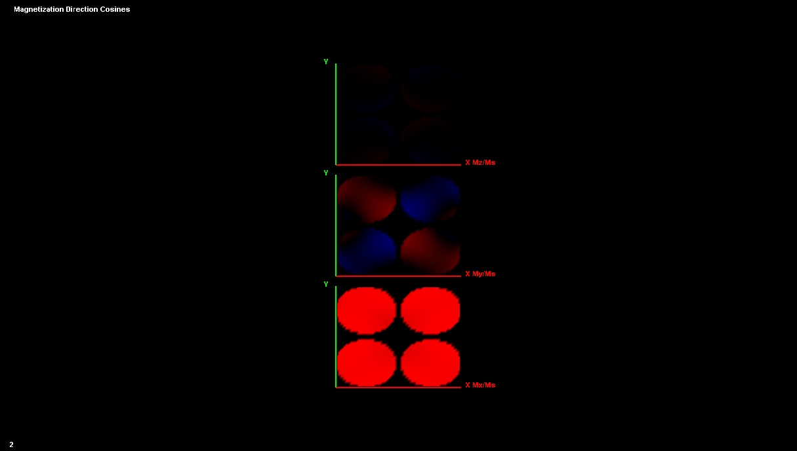
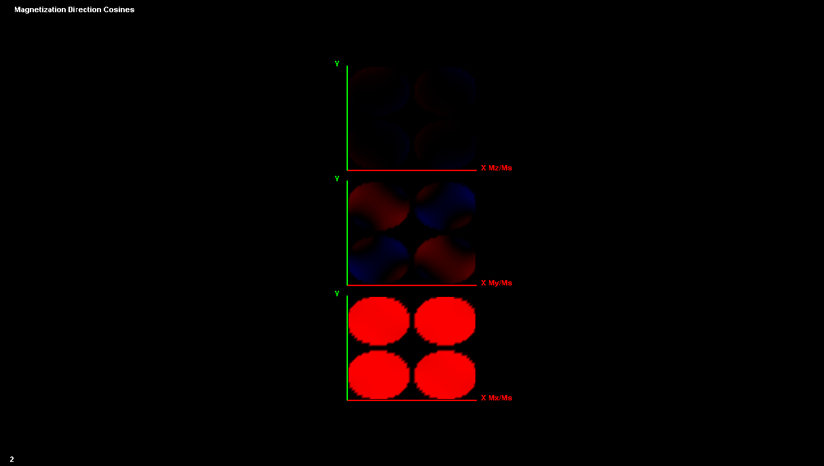
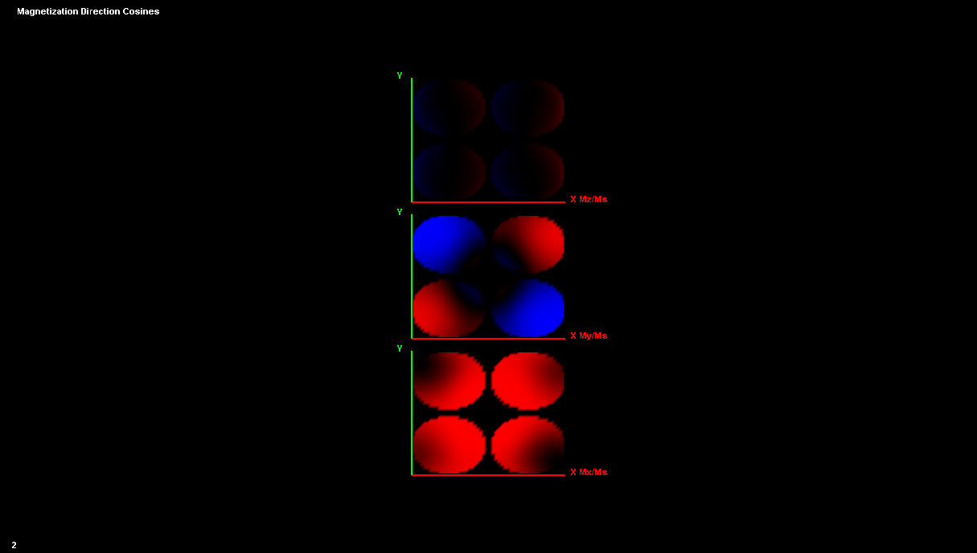
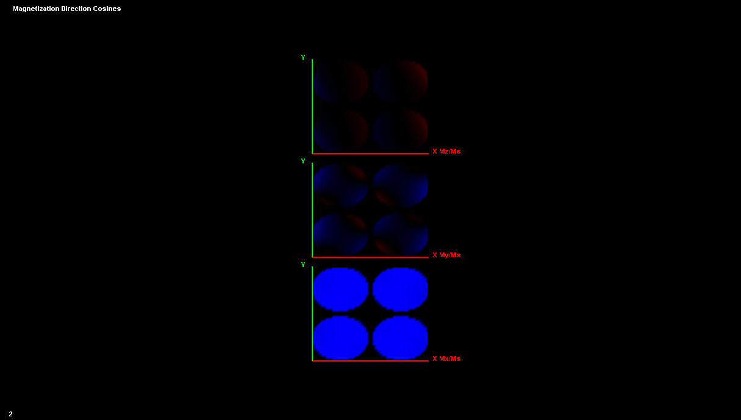
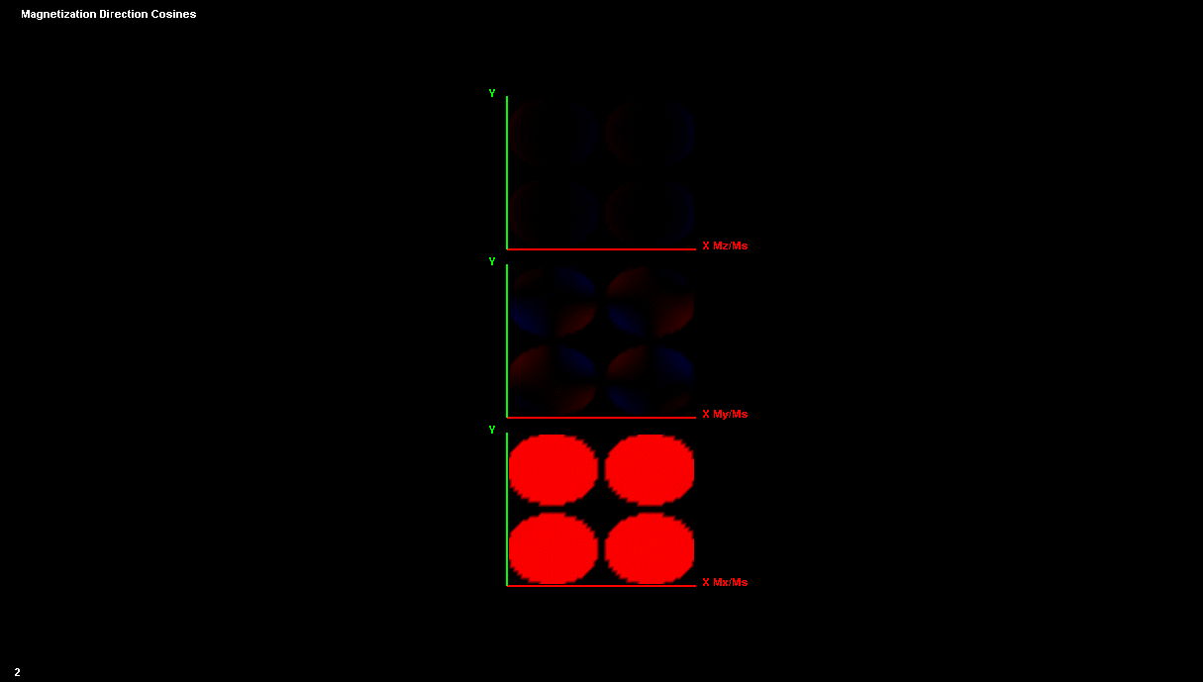
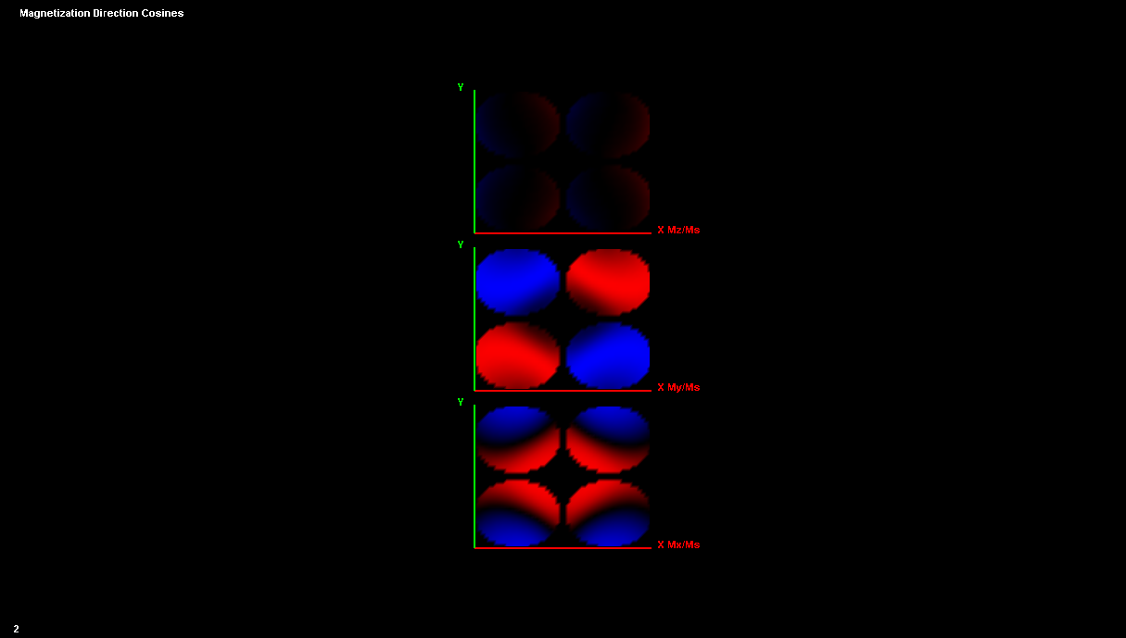
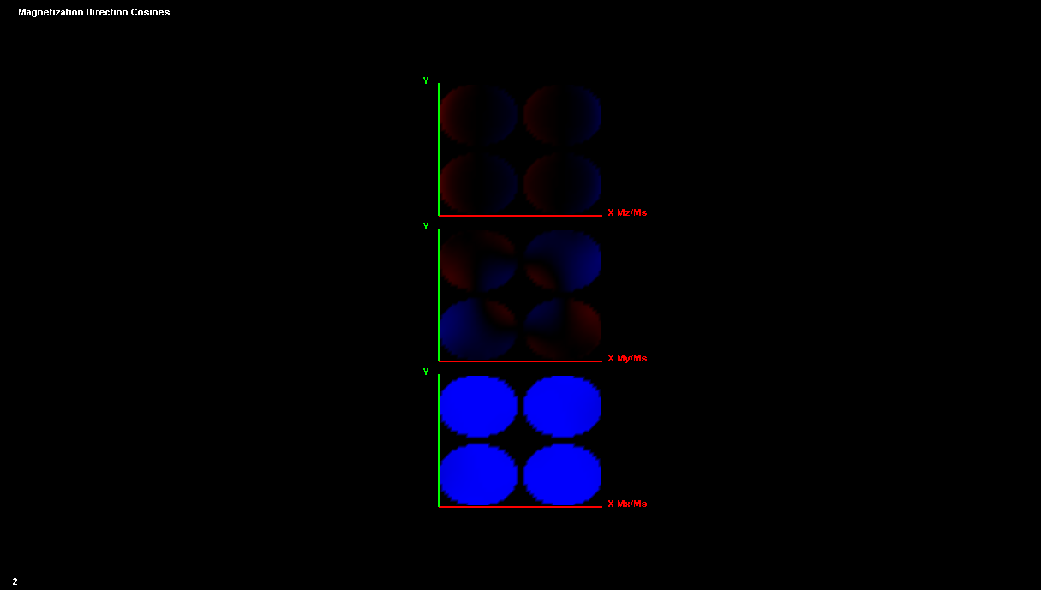

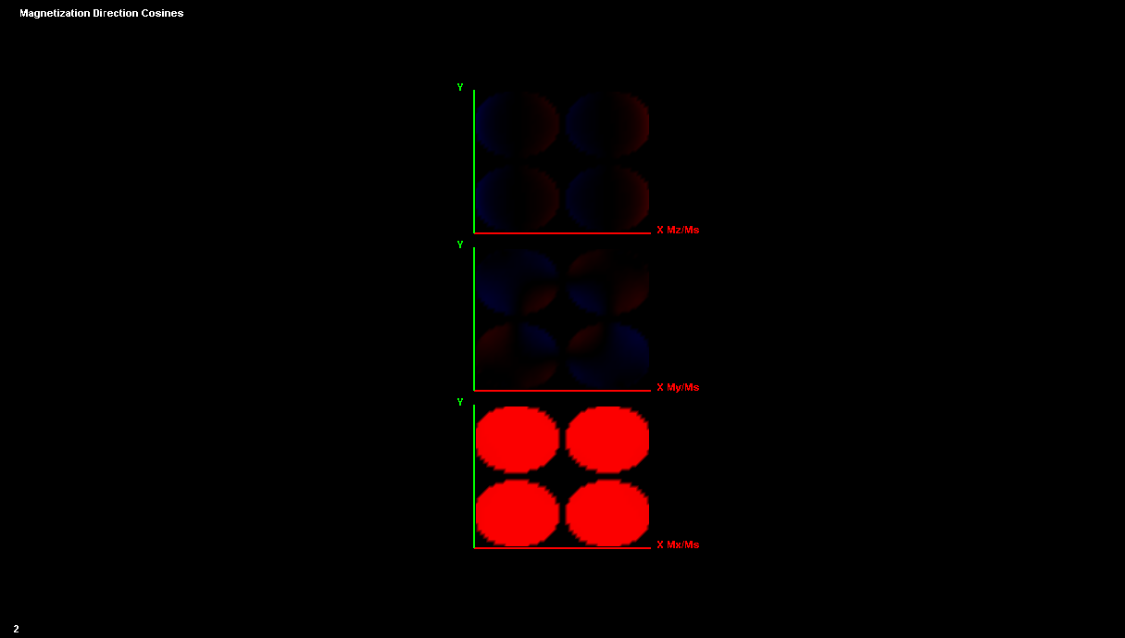
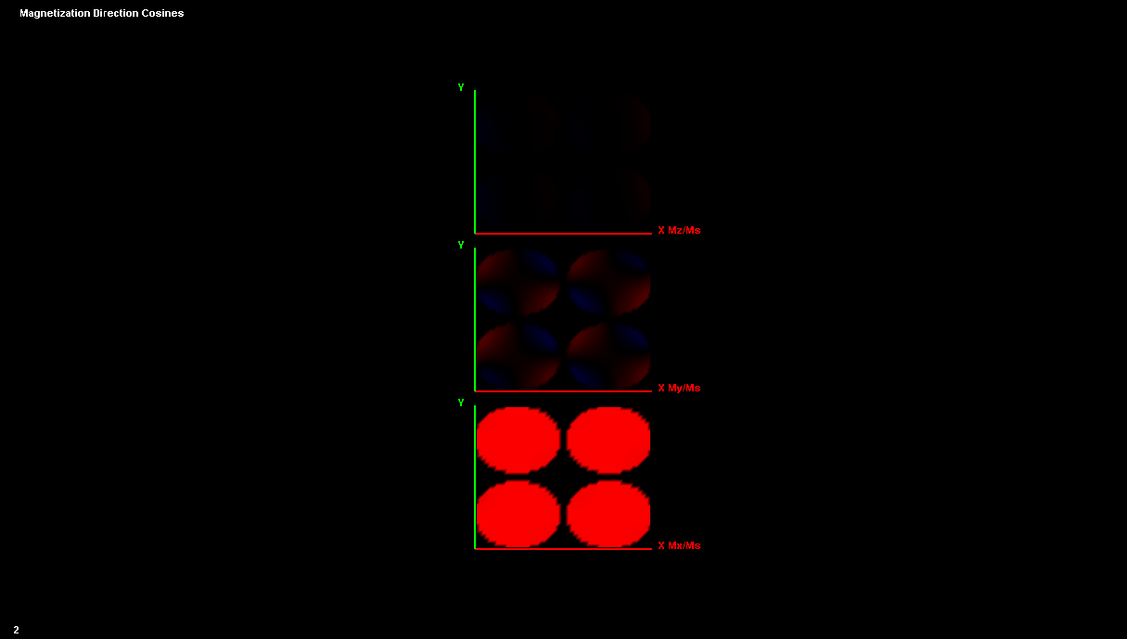
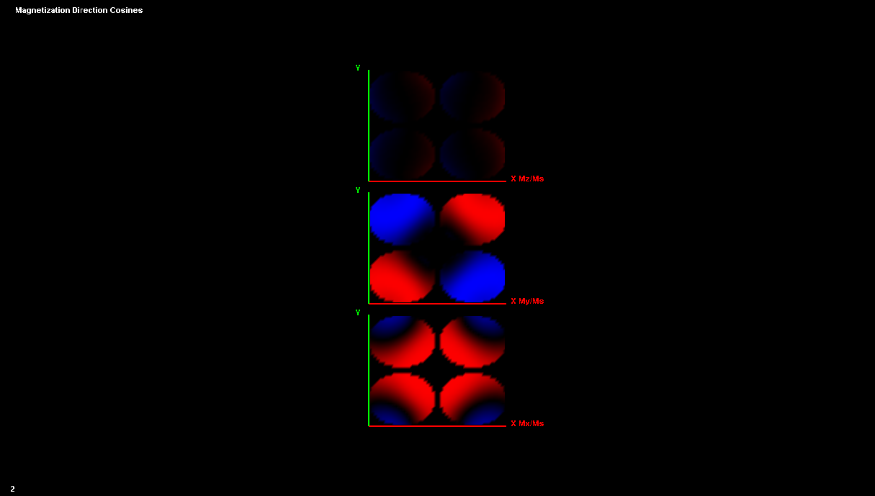
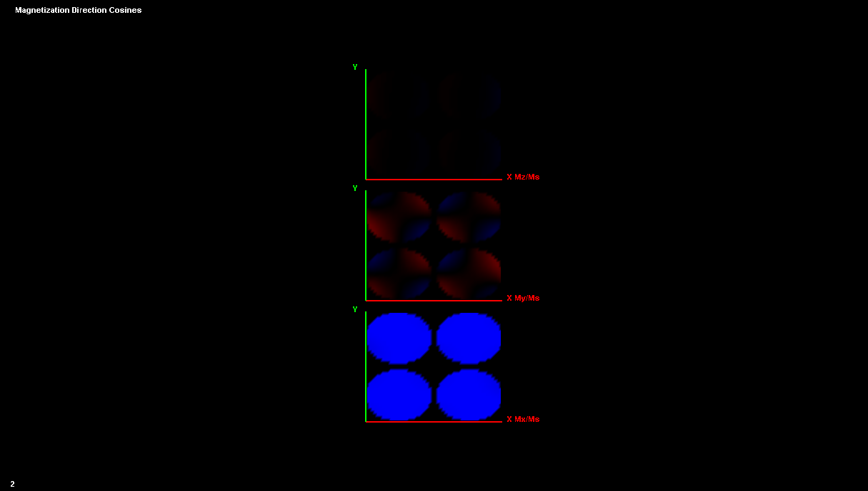
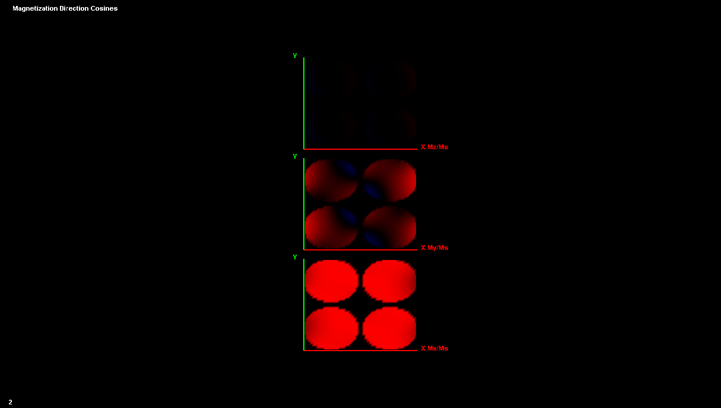
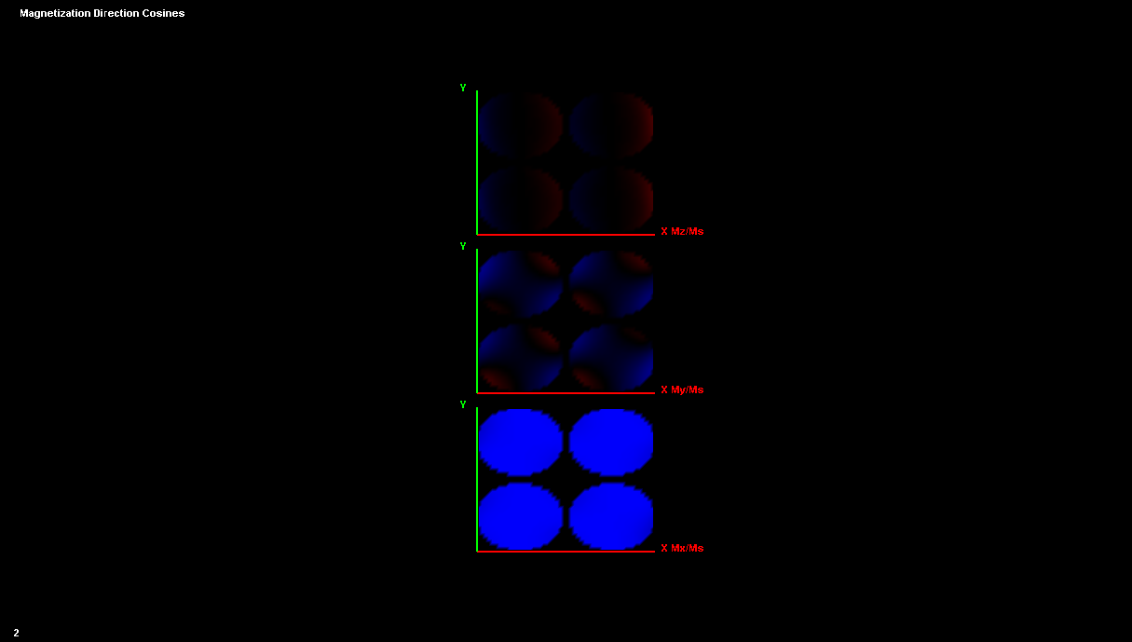
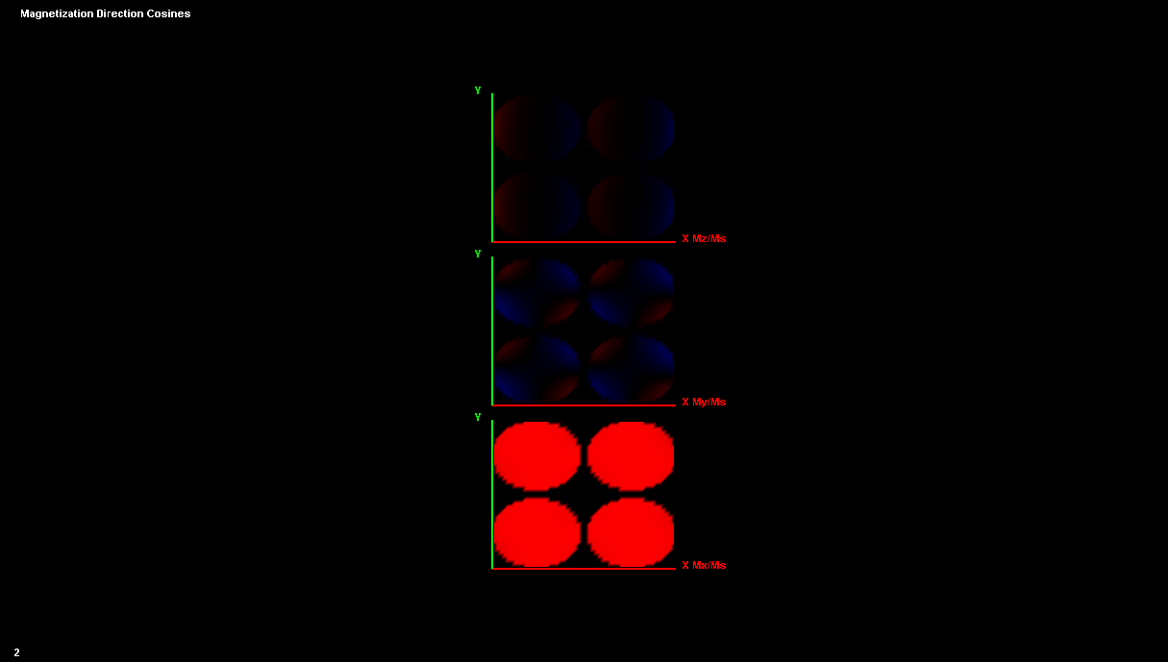
2x2 Elliptical Array, 125 nm x 100 nm, S = 10 nm
4
2
1
7
2
Co
Co
Py
Co
3
1
4
Co
Py
3
6
5
Py
Co
Py
8
5
8
Co
Py
Co
6
Co
Py
7
Py
Py

Slide 18
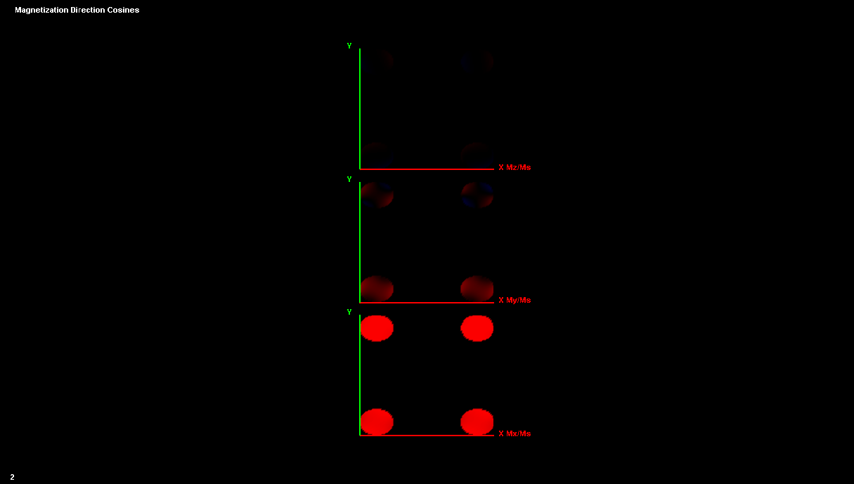
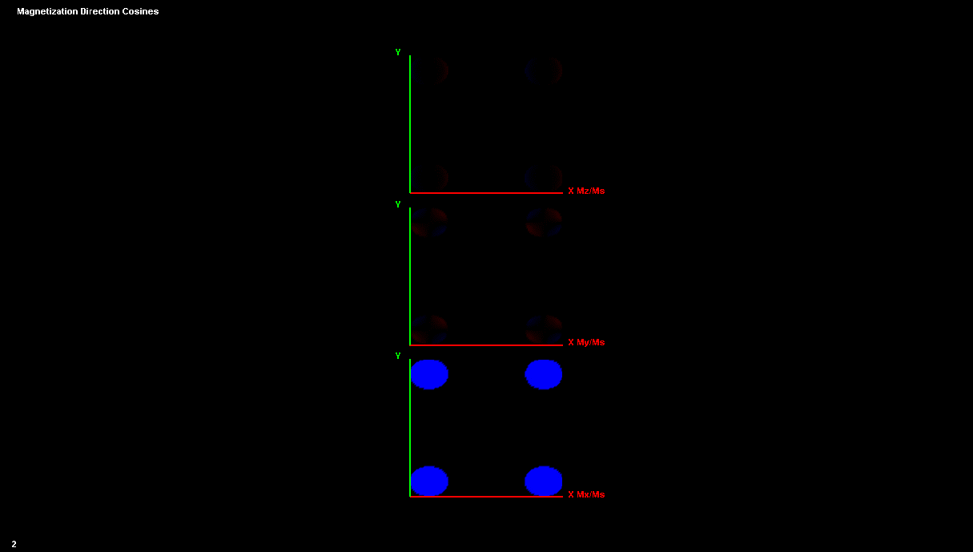
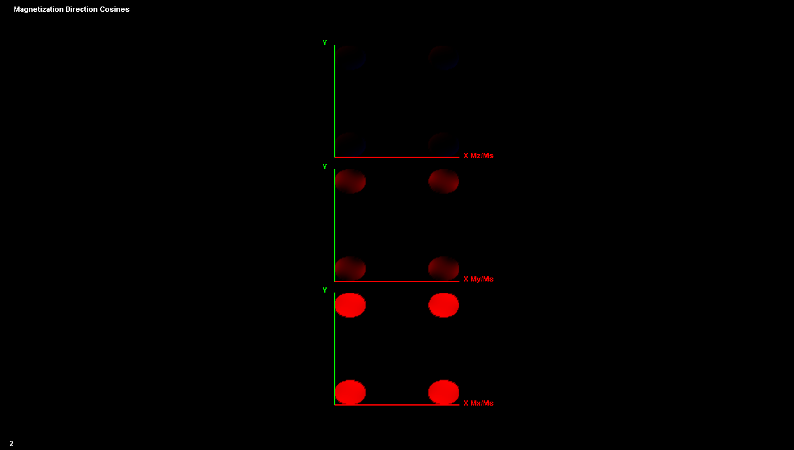
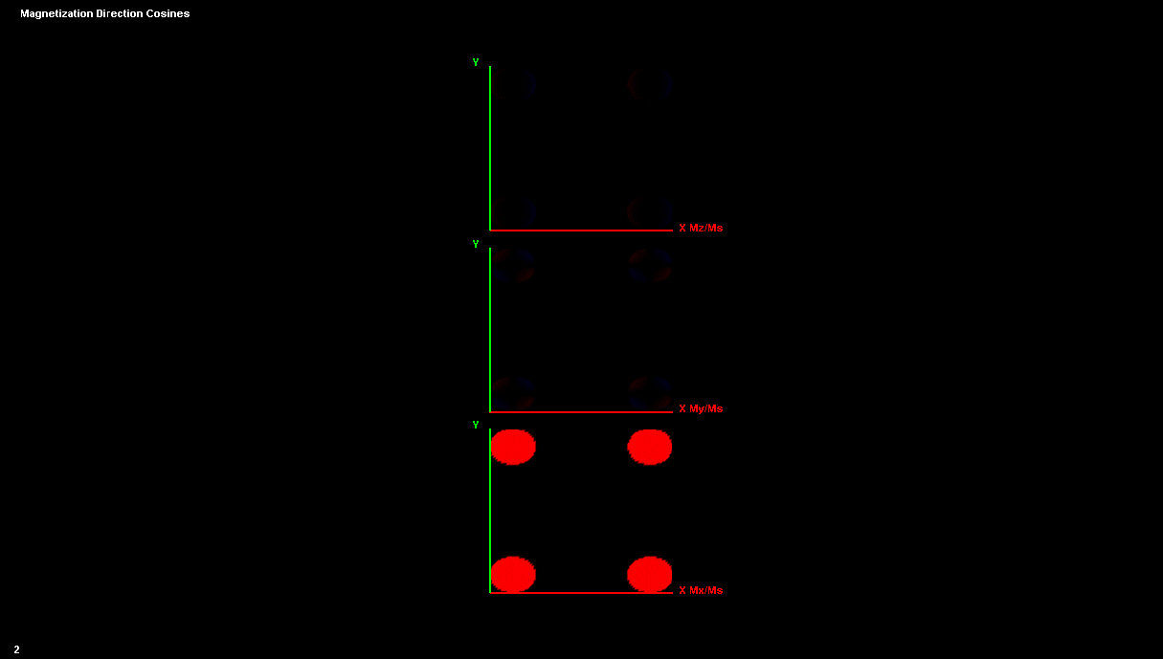
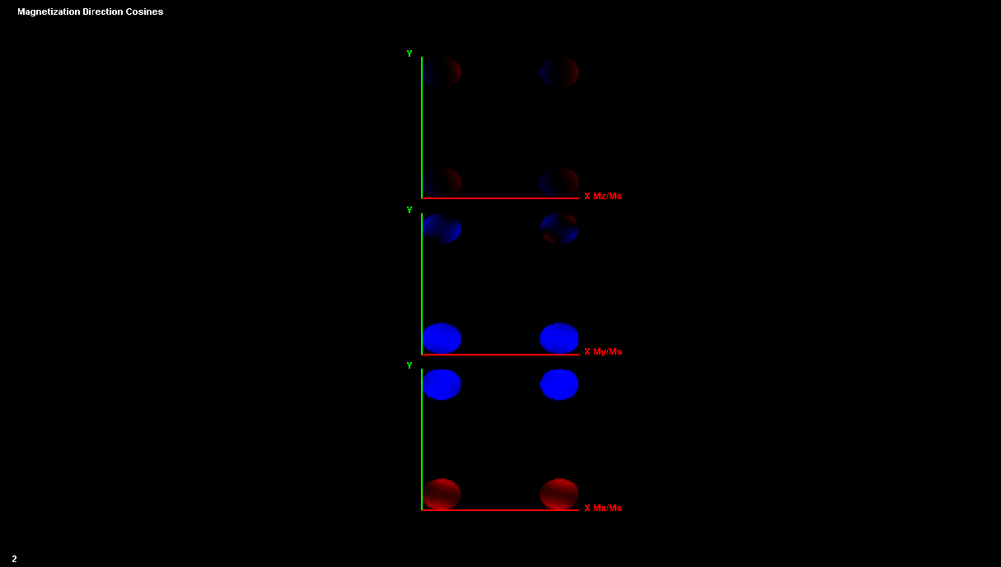

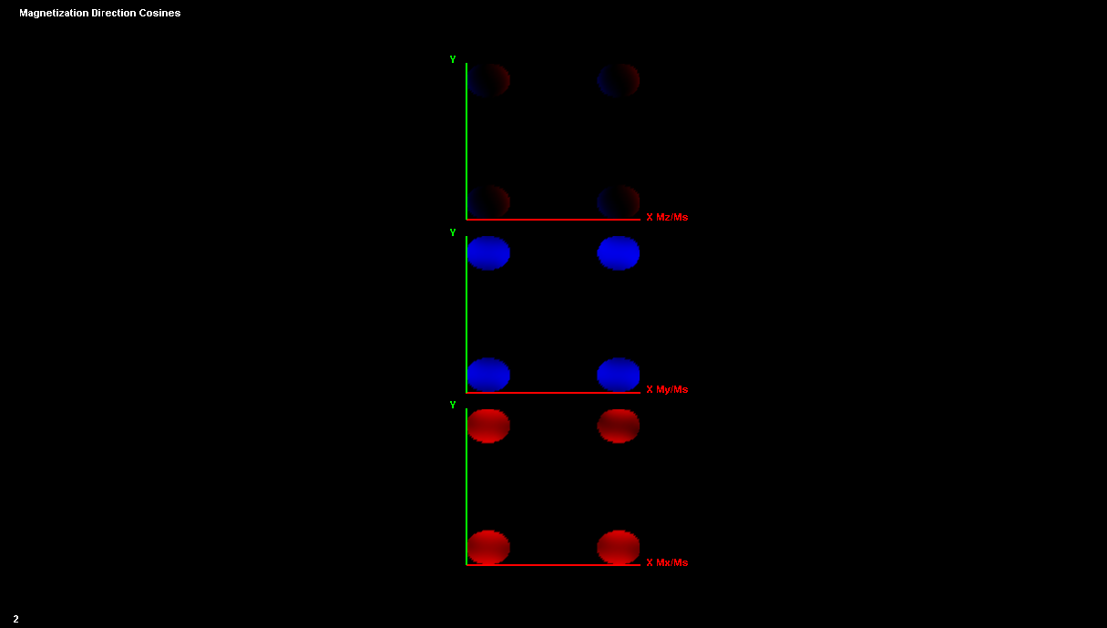

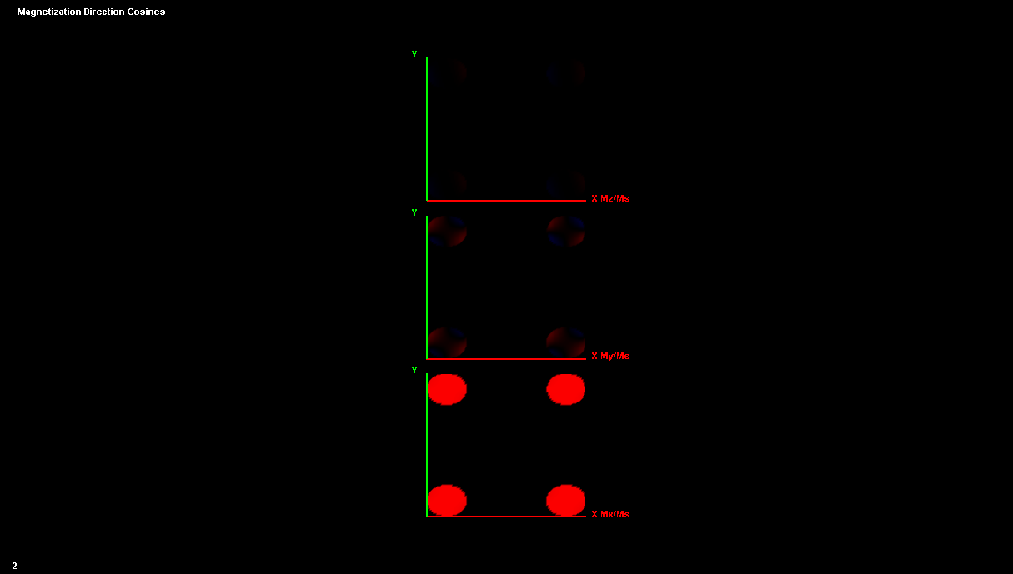

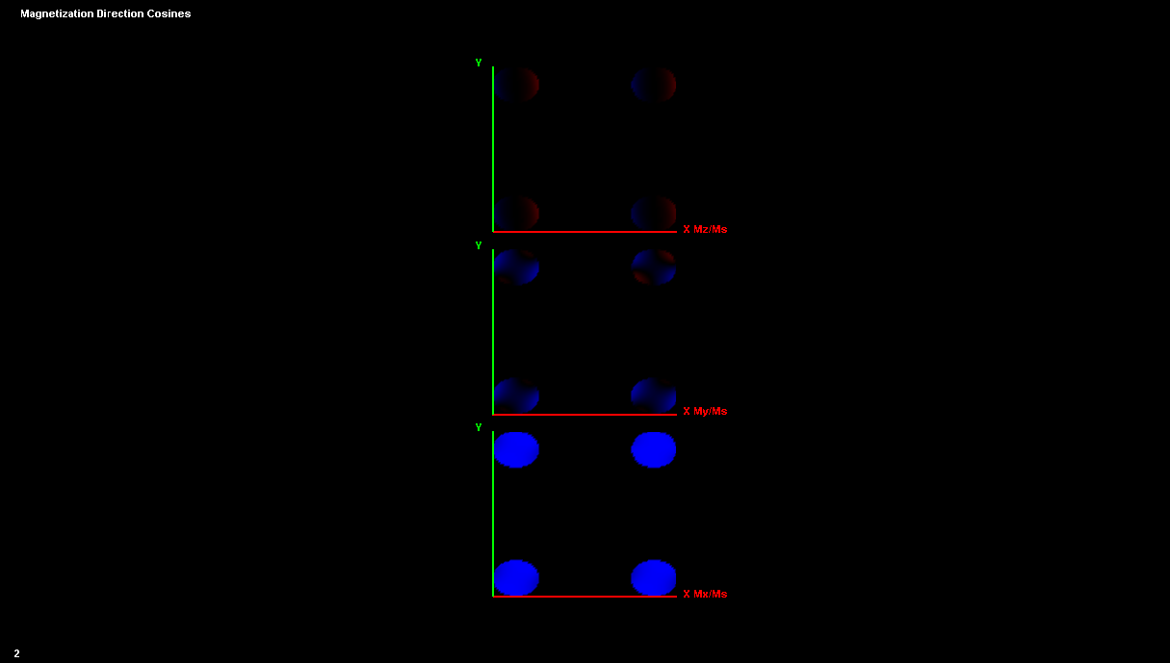
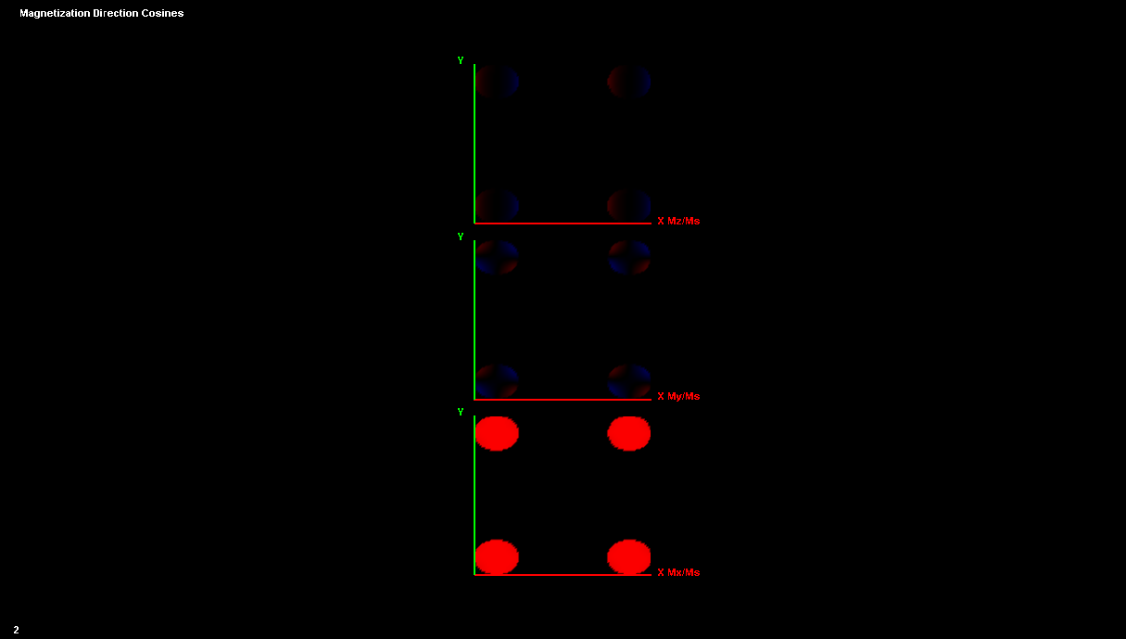
2x2 Elliptical Array, 125 nm x 100 nm, S = 250 nm
3
Co
1
5
Co
2
Co
2
1
Co
3
4
Py
Py
Py
6
Py
4
Co
6
Co
5
Py
Py

Slide 20
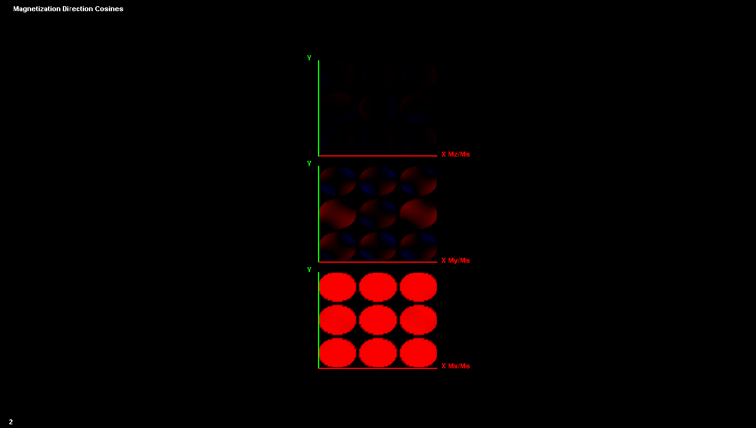
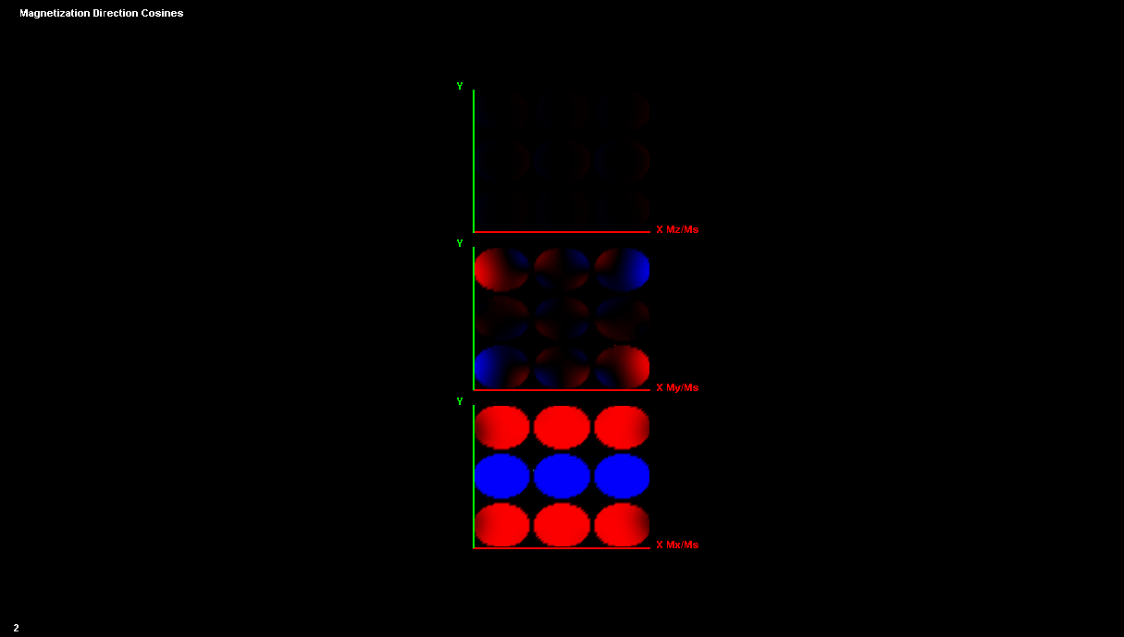

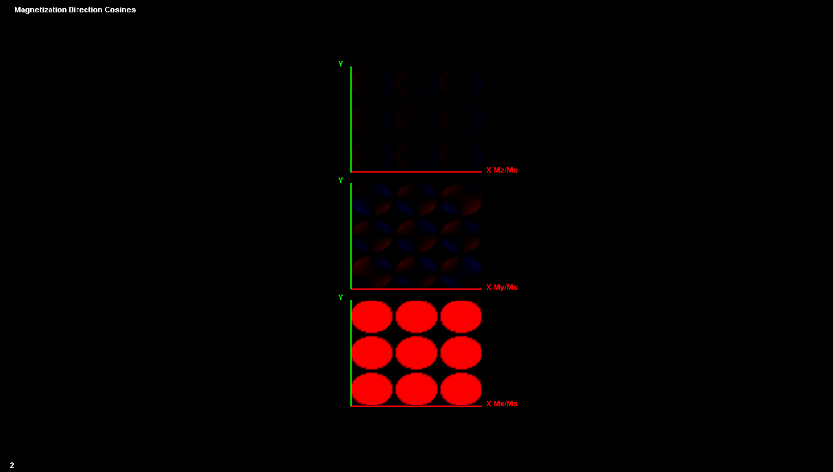
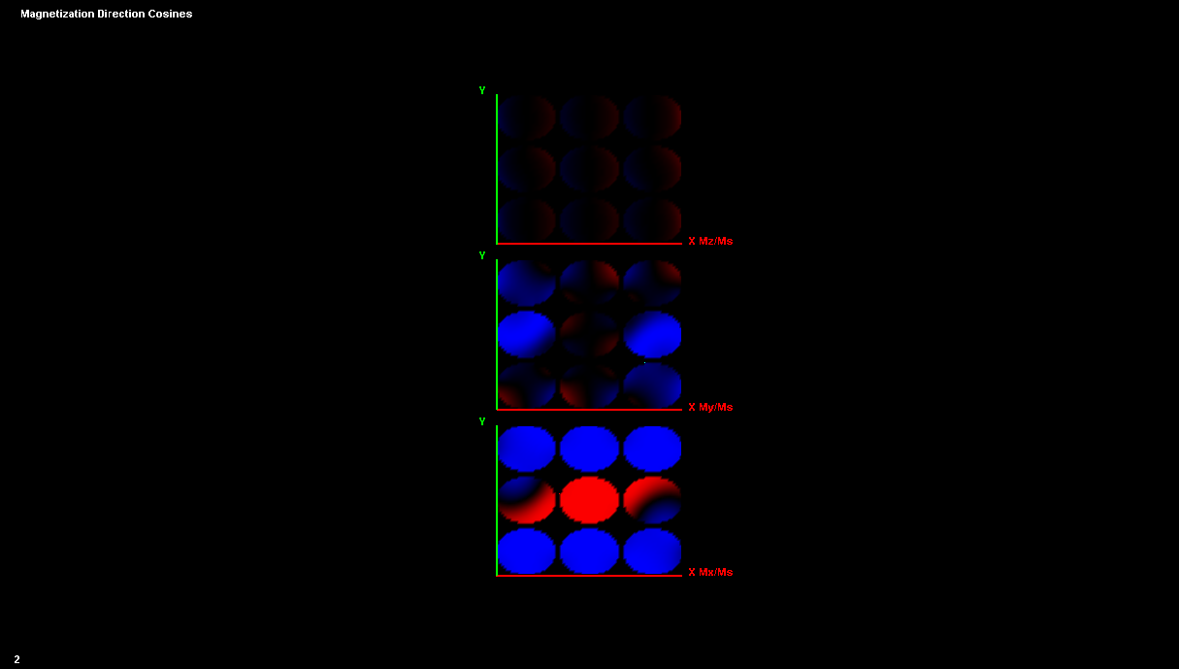
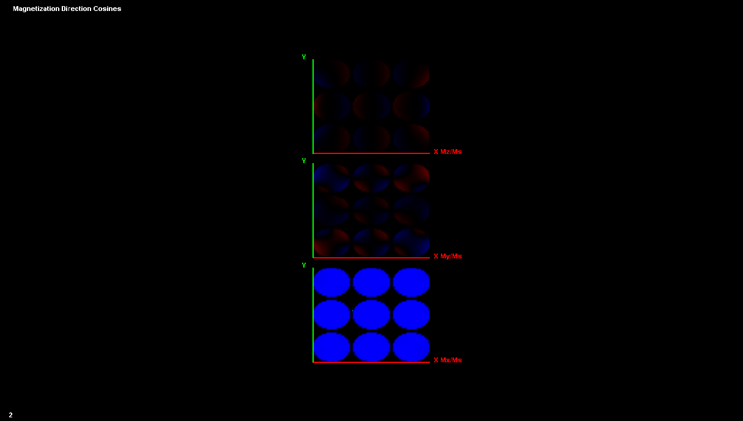
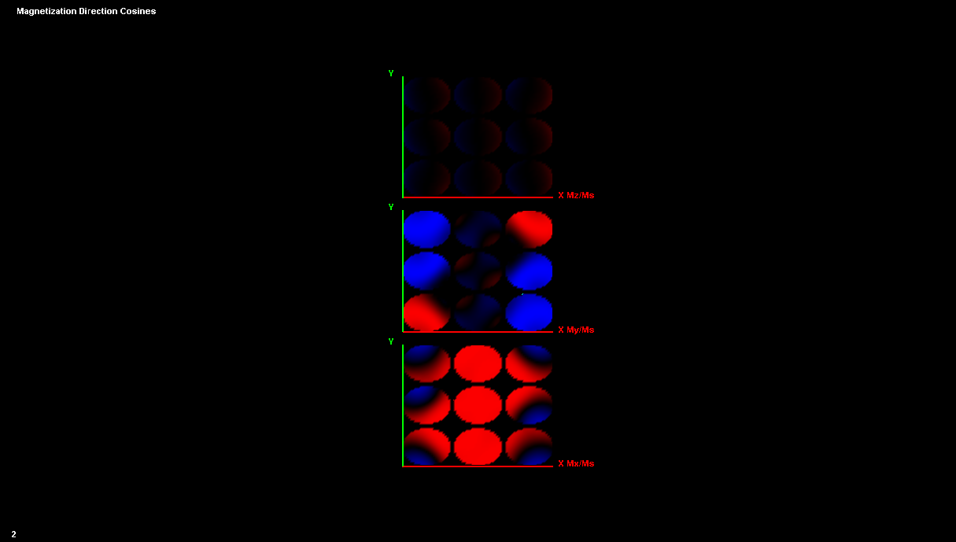
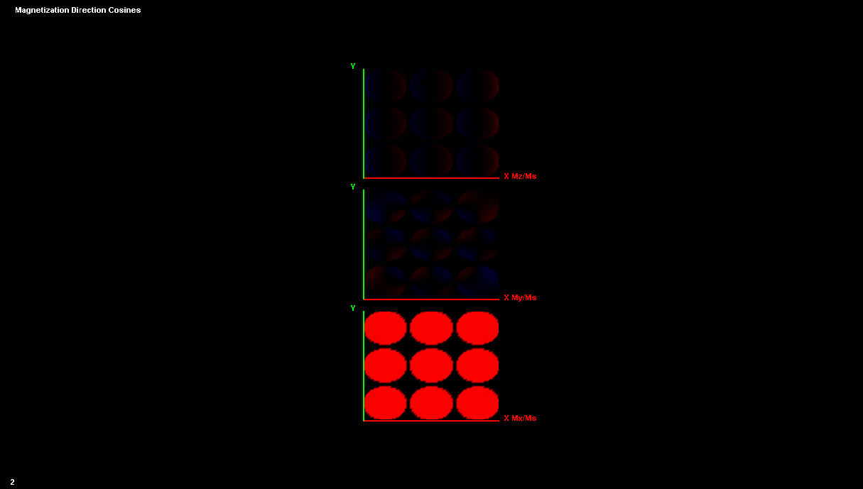
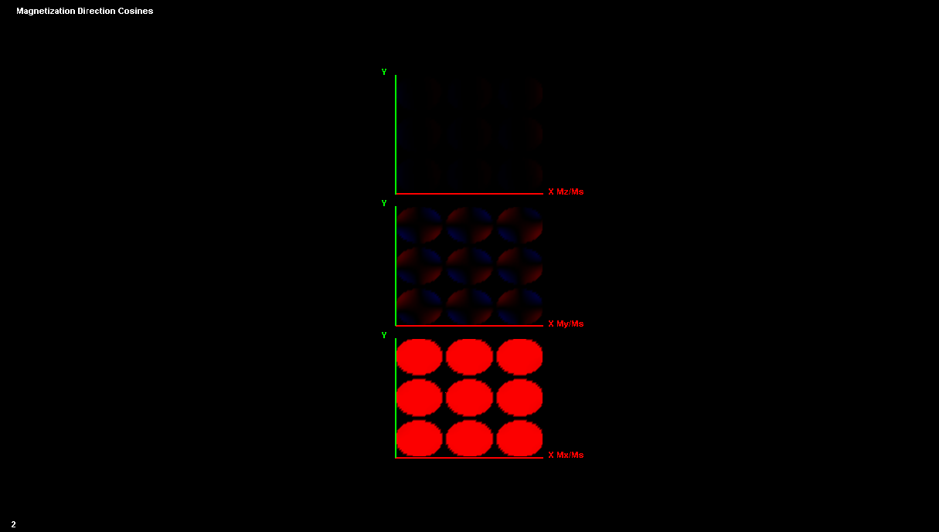

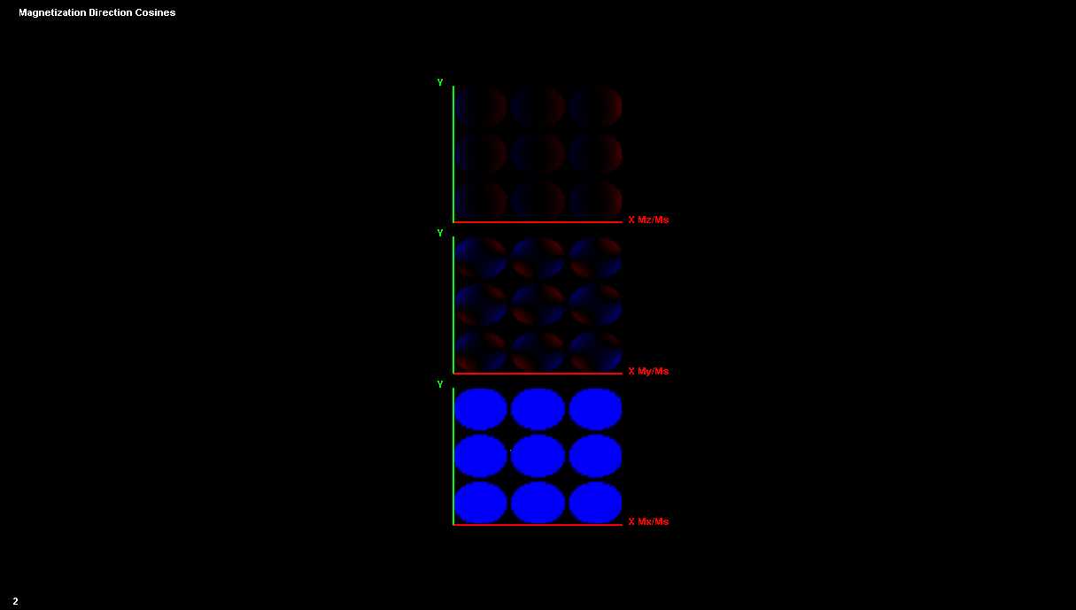
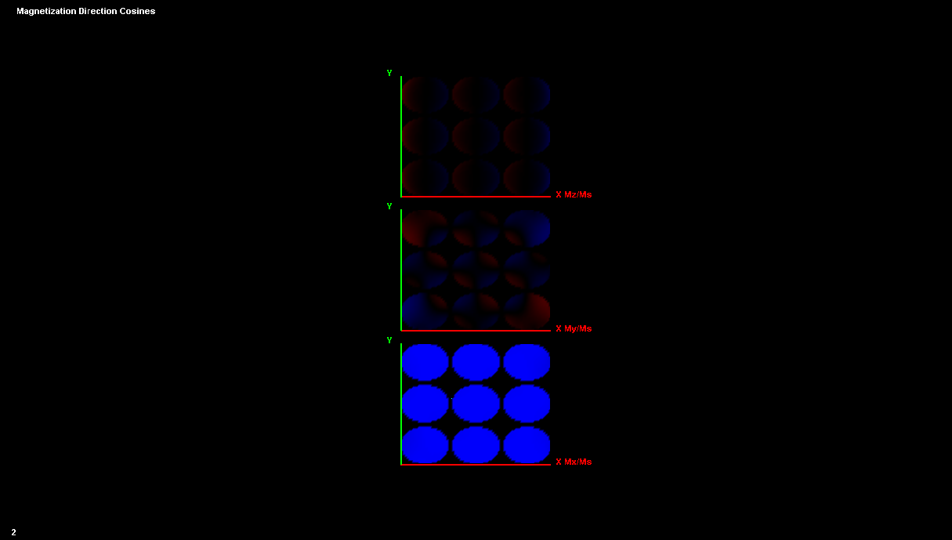

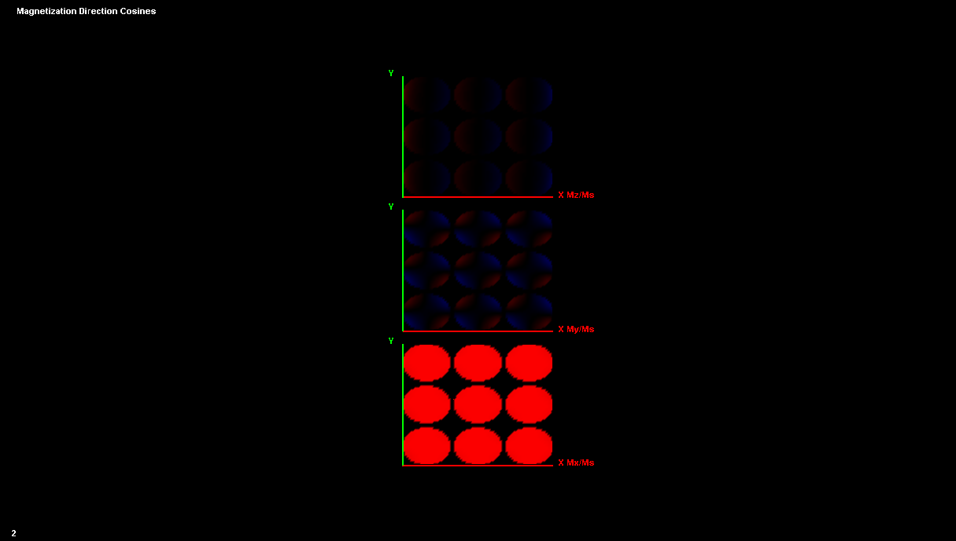
3x3 Elliptical Array, 125 nm x 100 nm, S = 10 nm
3
1
5
2
Co
2
Co
Co
1
3
Co
Py
4
Py
Py
5
7
Py
4
6
Co
6
Co
Py
Py
7
Co
Py

Slide 22
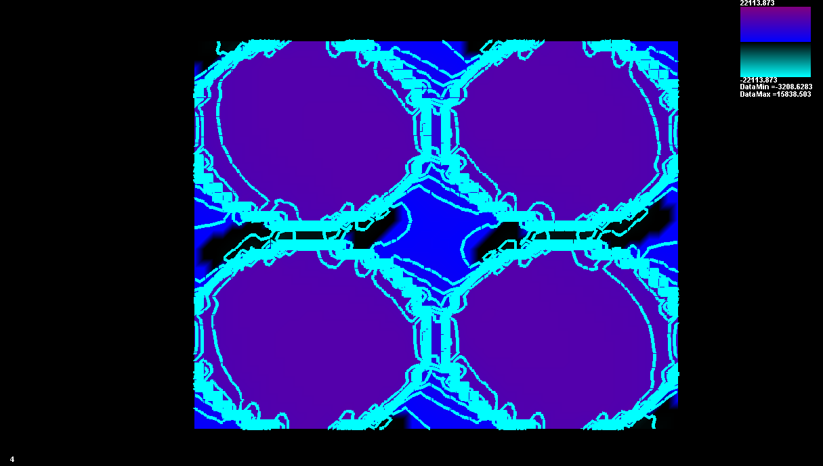
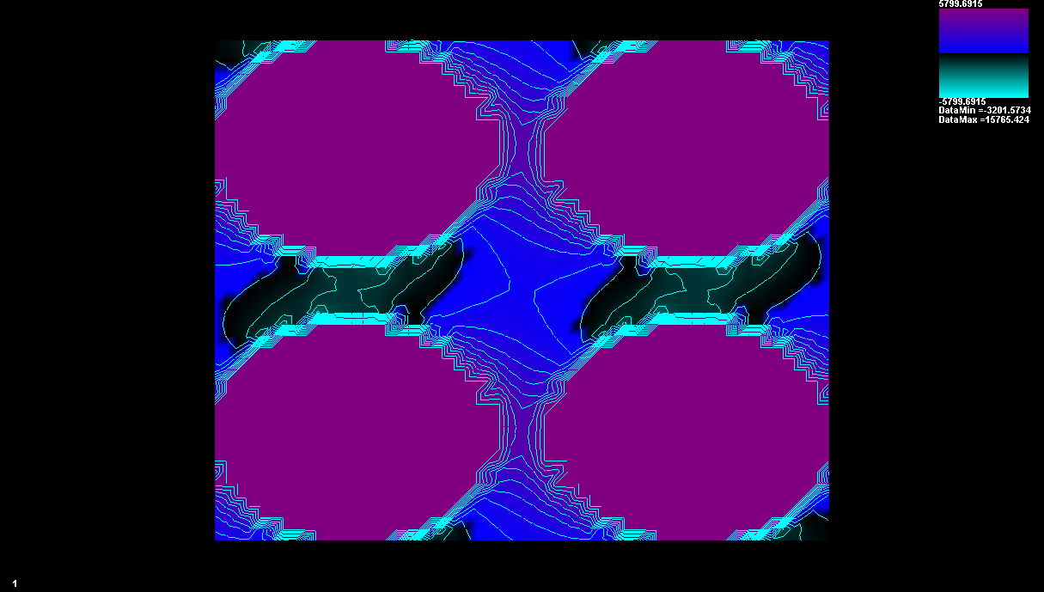
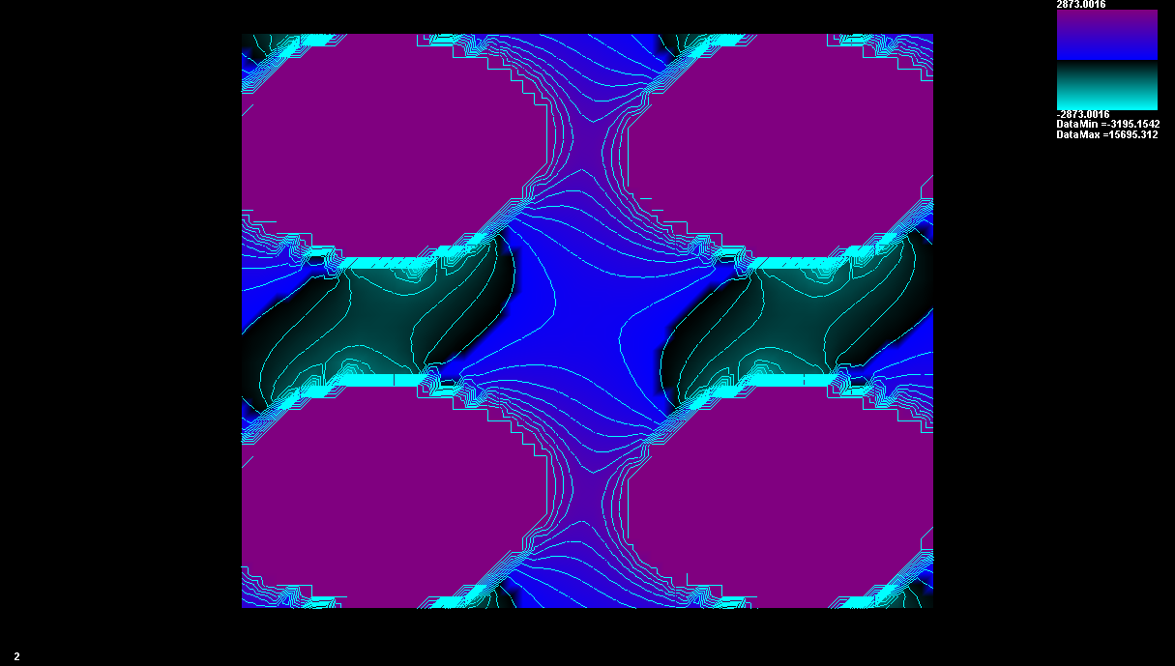
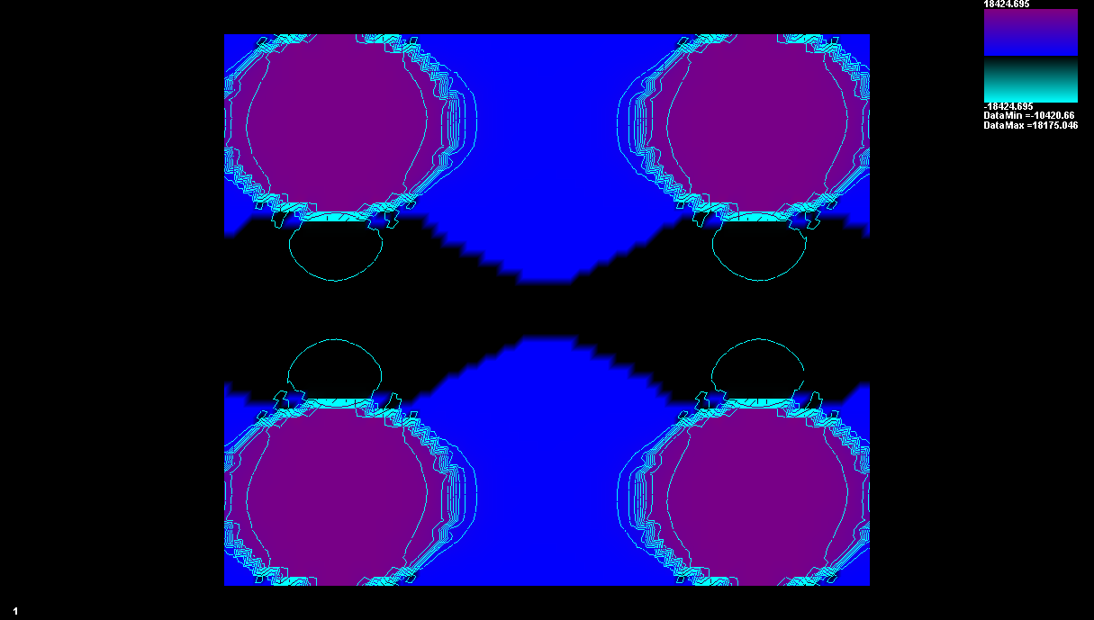
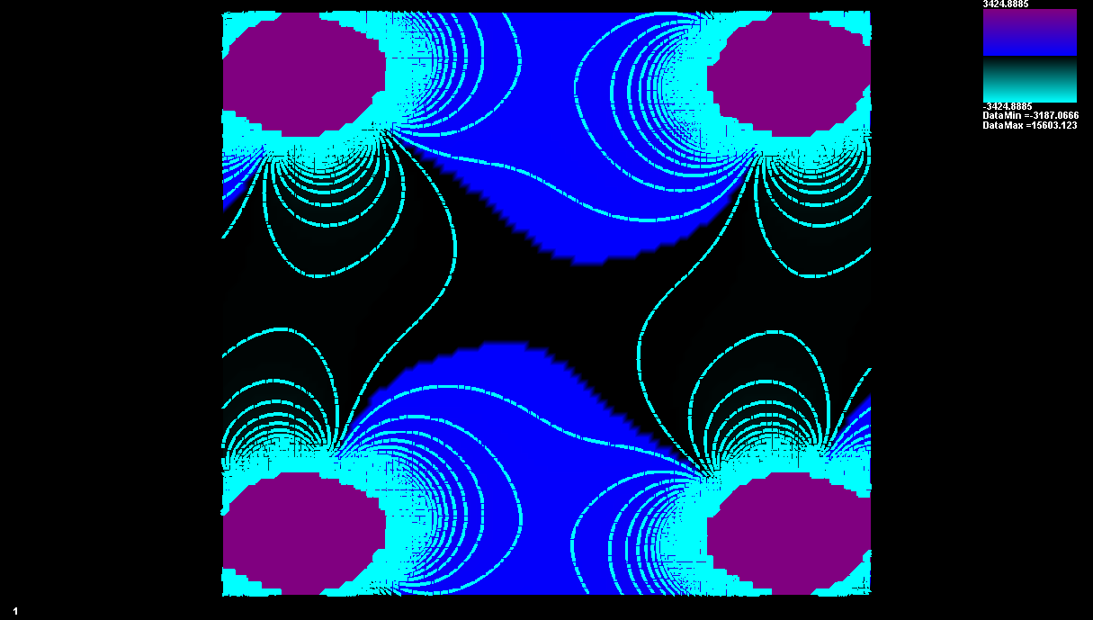
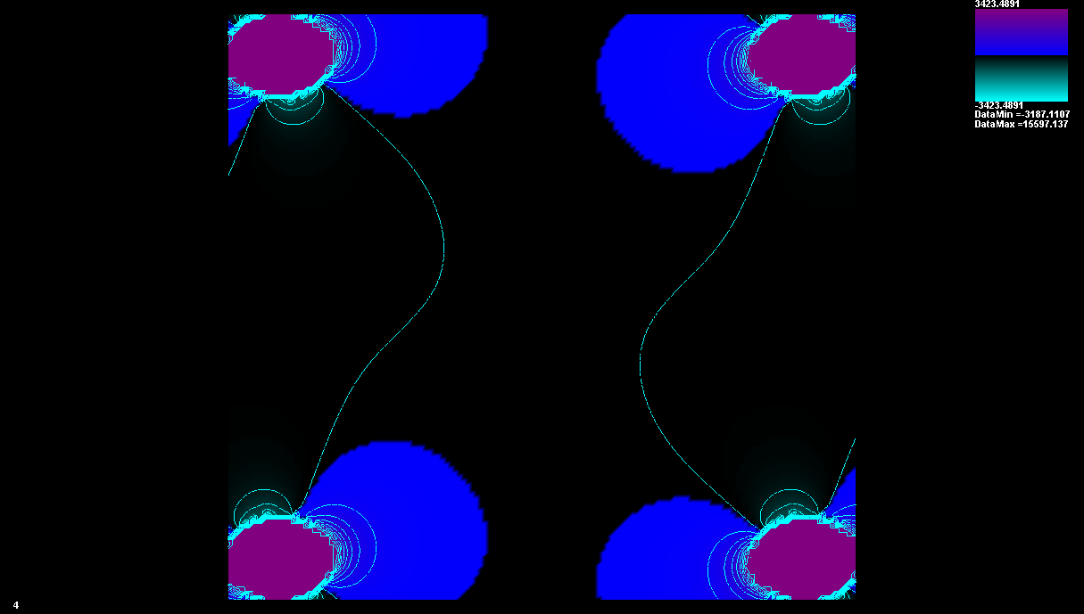
2x2 Elliptical Array (125 nm x 100 nm)
Magnetic Flux Density: Co Layer
S = 10 nm
S = 25 nm
S = 50 nm
S = 100 nm
S = 250 nm
S = 500 nm

Slide 23
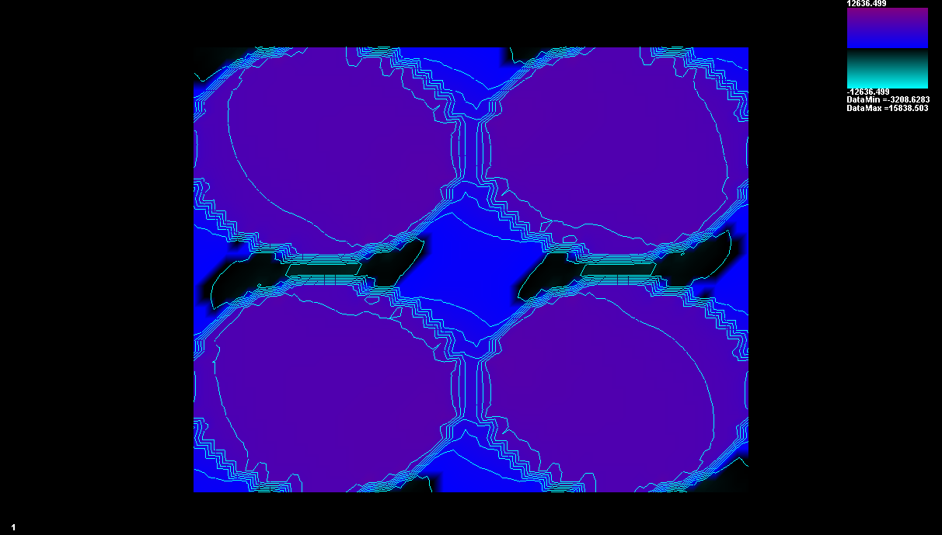
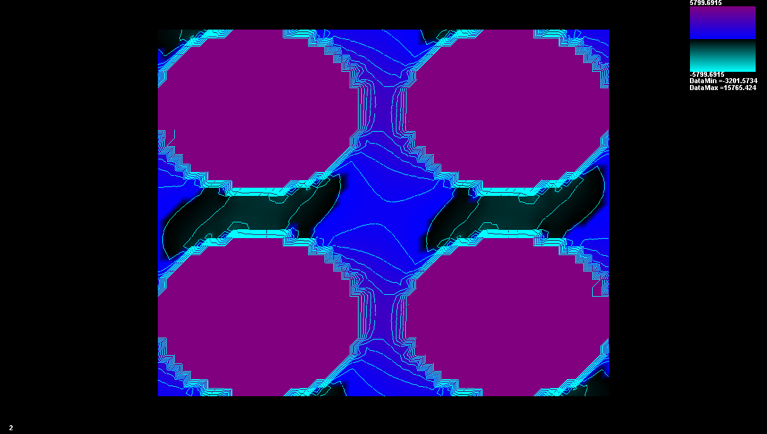
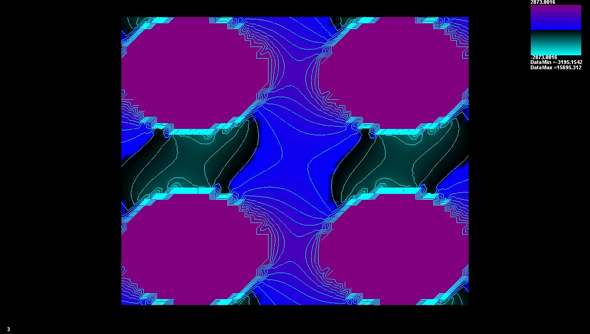
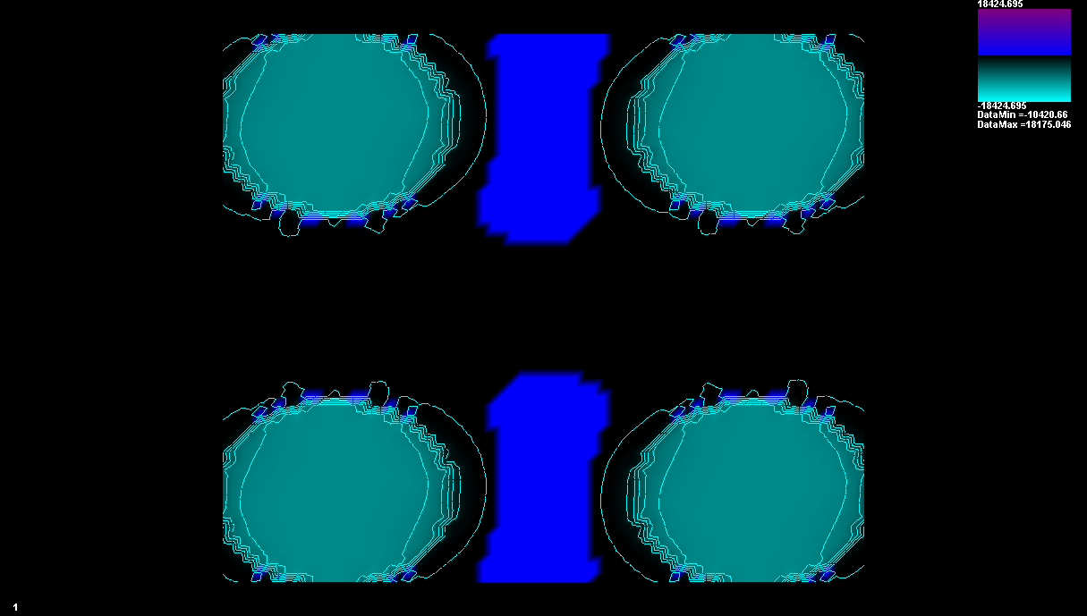
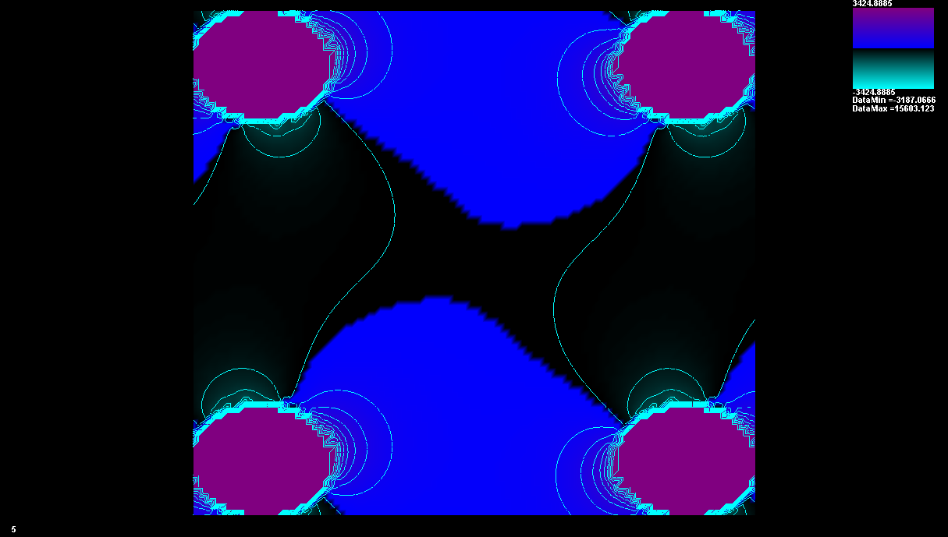
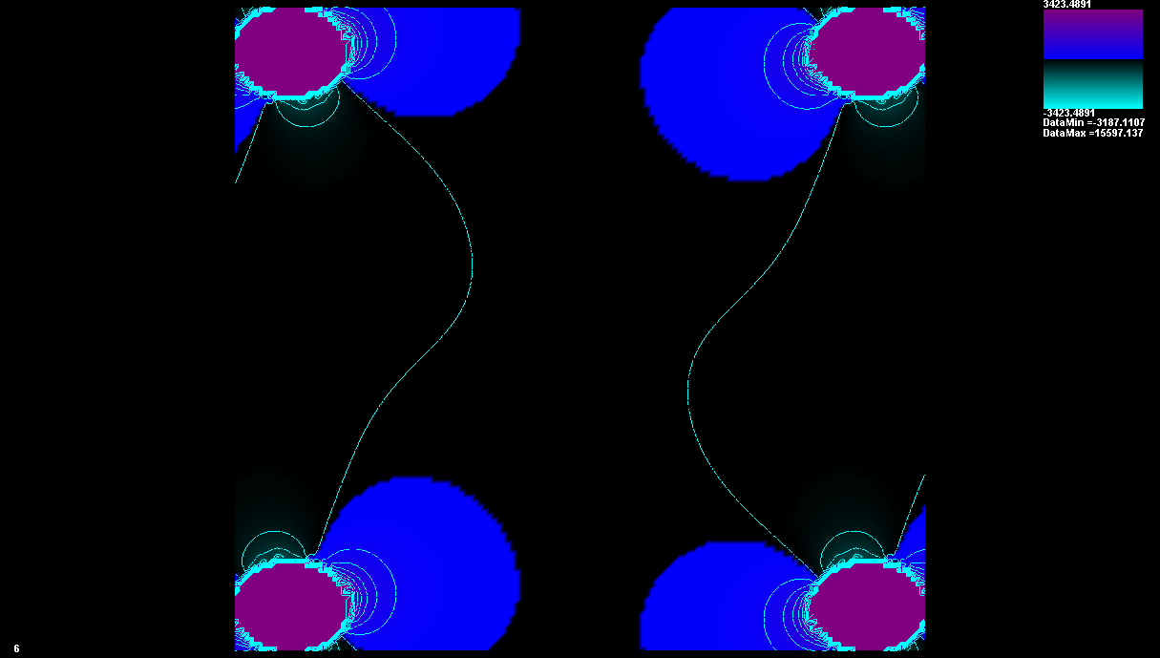
2x2 Elliptical Array (125 nm x 100 nm)
Magnetic Flux Density: Py Layer
S = 10 nm
S = 25 nm
S = 50 nm
S = 100 nm
S = 250 nm
S = 500 nm

Slide 24
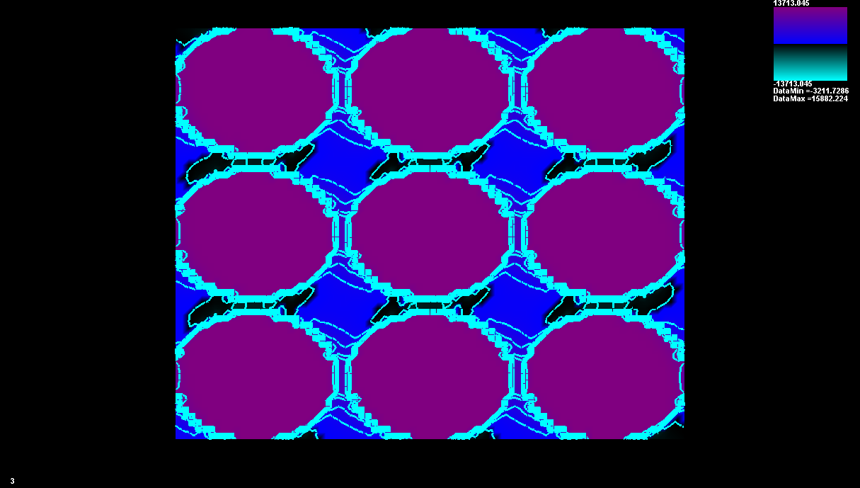
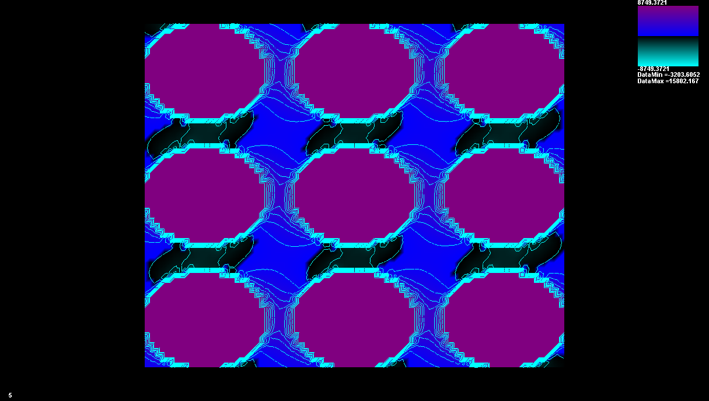
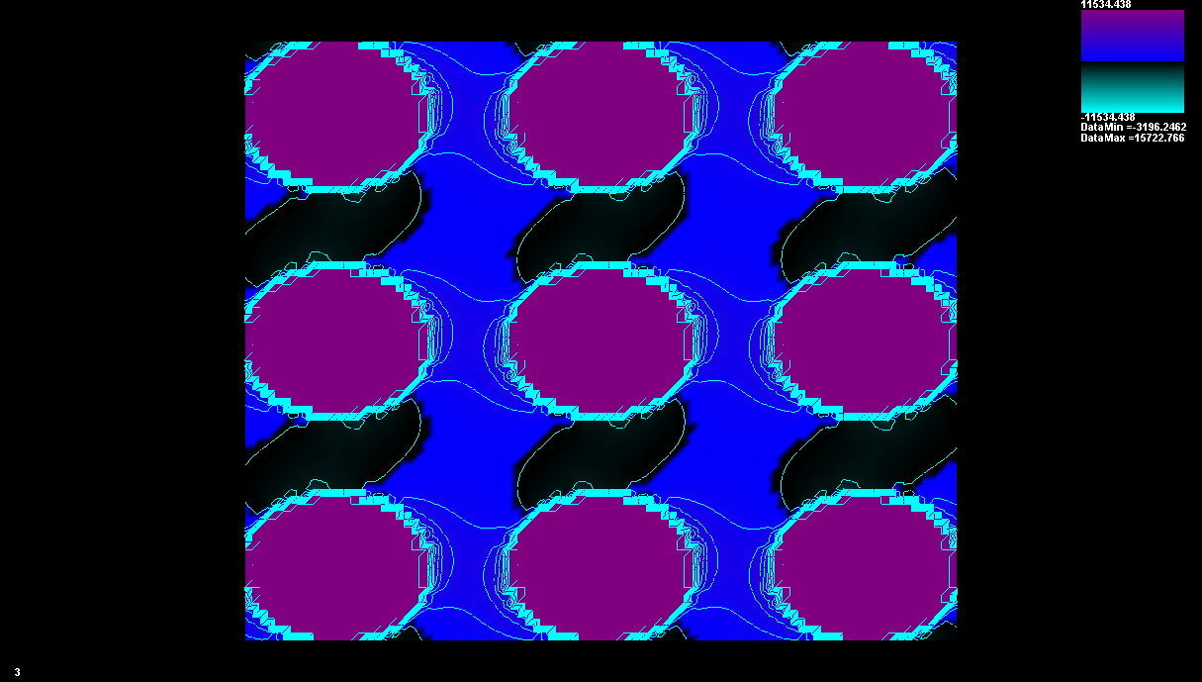
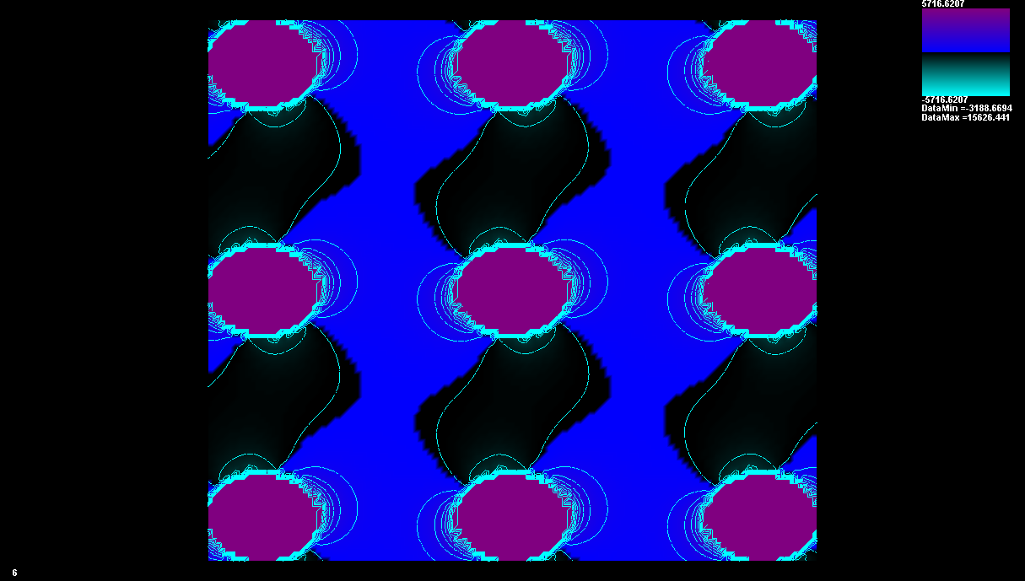

3x3 Elliptical Array (125 nm x 100 nm)
Magnetic Flux Density: Co Layer
S = 10 nm
S = 25 nm
S = 50 nm
S = 150 nm
S = 250 nm

Slide 25





3x3 Elliptical Array (125 nm x 100 nm)
Magnetic Flux Density: Py Layer
S = 10 nm
S = 25 nm
S = 50 nm
S = 150 nm
S = 250 nm

Slide 26
Co/Cu/Ni₈₀Fe₂₀ Rectangular
Co/Cu/Ni₈₀Fe₂₀ Elliptical

Slide 27
Co/Cu/Ni₈₀Fe₂₀ Elliptical: 2x2 Array
125 nm x 100 nm
Co/Cu/Ni₈₀Fe₂₀ Elliptical: 3x3 Array
125 nm x 100 nm

Slide 28












Rectangular Cell, 50 nm x 100 nm
Co
Py
Co
Py
1
2
Co
Py
Co
Py
3
4
5
Co
Py
Co
Py
6

Slide 29














Rectangular Cell, 150 nm x 100 nm
Co
Co
1
Co
Py
Py
Co
2
Py
3
Py
4
Co
7
Co
Py
Py
Co
6
5
Py

Slide 30














Rectangular Cell, 250 nm x 100 nm
1
Co
Co
2
Py
Py
Co
Py
Co
3
Py
4
Co
7
Co
Py
Py
Co
6
5
Py

Slide 31








Elliptical Cell, 50 nm x 100 nm
1
Co
Py
2
Co
Py
Co
Py
4
Co
Py
3

Slide 32












Elliptical Cell, 100 nm x 100 nm
1
Co
Py
2
3
Co
Py
Co
Py
6
Co
Py
4
Co
Py
Co
Py
5

Slide 33














Elliptical Cell, 125 nm x 100 nm
1
Co
Py
2
Co
Py
Co
Py
3
4
Co
Py
Co
Py
7
Co
Py
Co
Py
5
6

Slide 34








Elliptical Cell, 250 nm x 100 nm
1
Co
Co
Py
Py
2
4
Co
Co
Py
Py
3

